Slide 1
Enhanced Course Enrollment and Notification System
Team Name: Digital Catalysts Team Members: Kumbam, Sai Sri Harsha Martha, Harshith Nagabhyrava, Jaswanth Ram

Slide 2
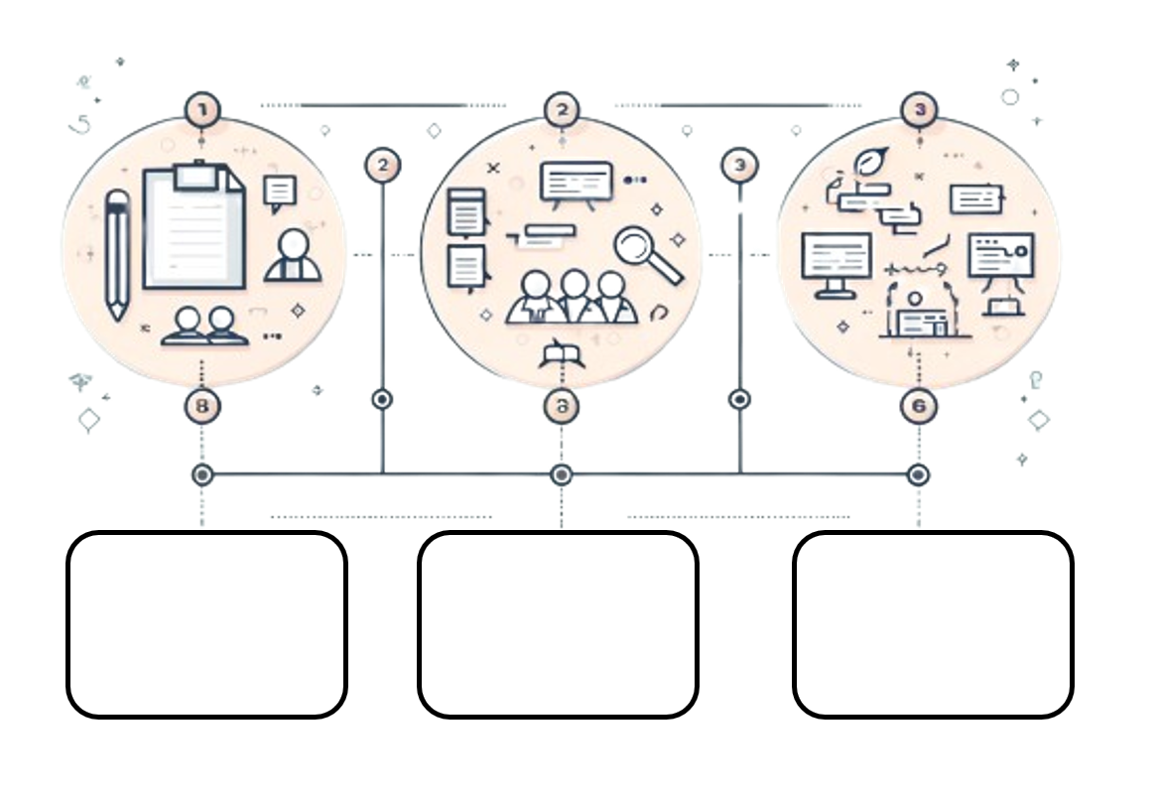
System Request
Diagrammatic Representation
Requirements

Slide 3

Notification
Enrollment
Waitlist

Slide 4
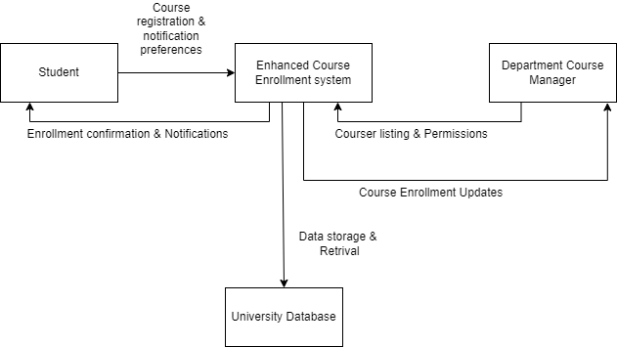

Context Level Diagram

Slide 5
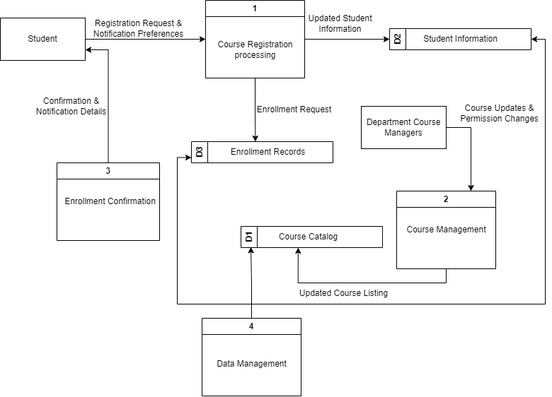
DFD Level 0

Slide 6
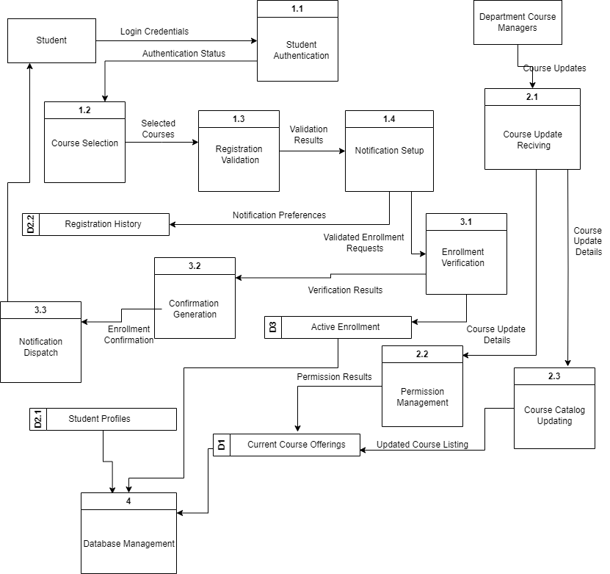
DFD Level 1

Slide 7
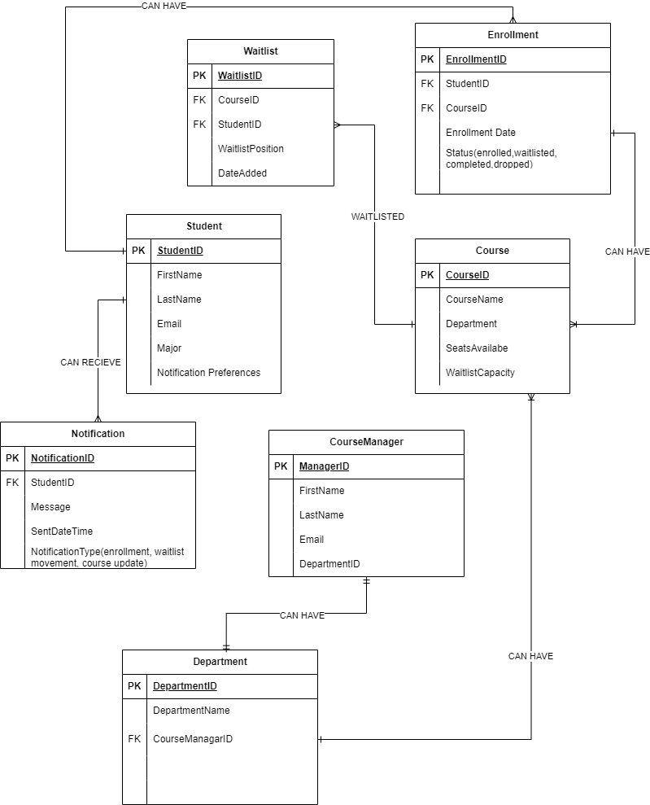
Entity Relationship Diagram

Slide 8
THANK YOU
QUESTIONS?

